Slide 1
Wavelength 09.11.2022

Slide 2
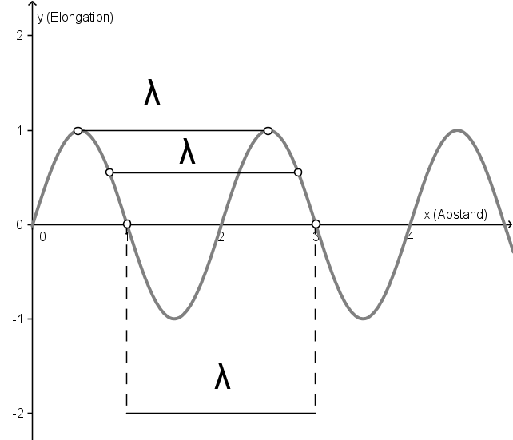
Measurement

Slide 3
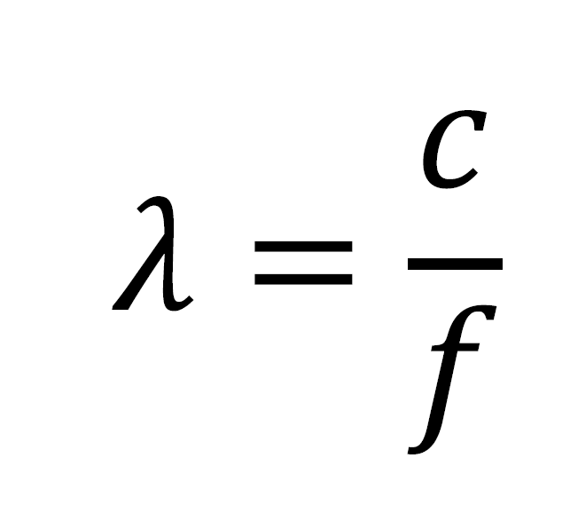

Calculation

